Slide 1

STAKEHOLDER MOBILIZATION with NETMAP
Frankfurt, March 06, 2014
Benjamina Randrianarivelo
World Bank Institute
Operations Officer
Leadership & Governance
(WBILG)
1

Slide 2
NET-MAP?
A hands-on mapping tool that helps reform teams to:
  master the people side of change;
  better understand the stakeholder networks that influence their success.
Applying Net-Map allows increased impact.

Slide 3
CONTEXT:
LITERAVIA S.E.Z CASE
Reform: Set up an SEZ (Special Economic Zone) to reinforce the existing industry cluster, attract new investment, generate more employment, transform it into a growth pole and establish a regional transport hub in the country.
Rationale: Build upon LOGISTICS and create an SEZ around an efficient cluster of industry players involved in packaging, truck fleet management, warehousing, label printing, and inventory management.

Slide 4
WHAT NEEDS ARE CRITICAL AT THIS STAGE?
Many people with conflicting goals are involved => seek for support to:
  better understand actor networks and games played;
  anticipate possible pitfalls and conflicts;
  engage among partners and develop coalitions,
  engage with powerful supporters and detractors.
  And thus, develop strategies to mobilize various constituencies and better get ready for action.

Slide 5
SO HOW CAN REFORM TEAMS BE HELPED?
Respond the following question:
“Who’ll influence the success of this reform?”
For reminder, the reform is aiming at setting up a special economic zone (SEZ) to reinforce the existing industry cluster, attract new investment, generate more employment, transform it into a growth pole and establish a regional transport hub in the country”

Slide 6
HOW TO PROCEED THEN?
Let’s decline this main question down to four (04) sub-questions:
• Who are involved in the process?
• What are their formal and informal links?
• What do they want?
• How influential are they?

Slide 7
SET UP THREE (03) GROUPS
Let’s split in three (03) groups of equal number of members.
One person volunteers to facilitate each group.
Another one for note taking.
Let’s answer to each of those four (04) questions.

Slide 8
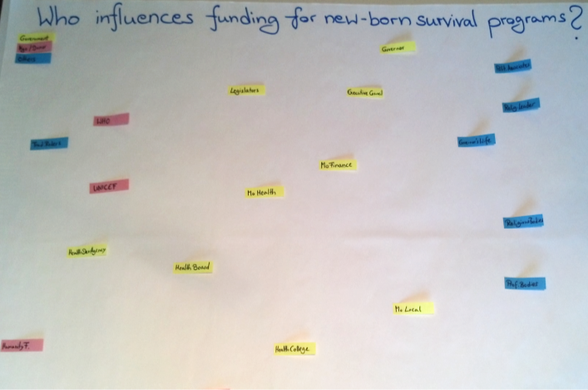
WHO ARE INVOLVED IN THE PROCESS? (1/2)

Slide 9
WHO ARE INVOLVED IN THE PROCESS? (2/2)
Define categories of actors involved in the reform. Example: Political authorities; Public administration; Private sector; Civil society; International institutions; … Take a maximum of 05.
Assign one (01) color per category of actors.
Note the names of all individuals, groups and organizations that will influence the outcome of the reform [One (01) card per actor].
Distribute those actor cards on an empty flipchart paper.

Slide 10
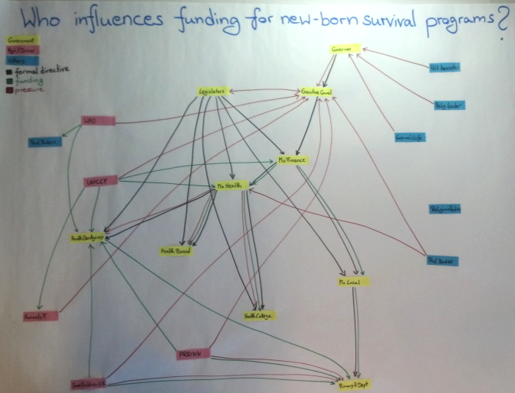
WHO IS LINKED TO WHOM? (1/2)

Slide 11
WHO IS LINKED TO WHOM? (2/2)
Define different kinds of formal and informal connections (e.g. money flow, hierarchy, conflict, political pressure, reporting…);
Draw them as arrows between the actor cards;
Ex. Money flow: Who gives money to whom?
Choose links which are very different from each other;
Include formal and informal links;
Avoid general links (which do not say much);
Consider adding negative links (ex. conflicts);
One color per kind of link.

Slide 12
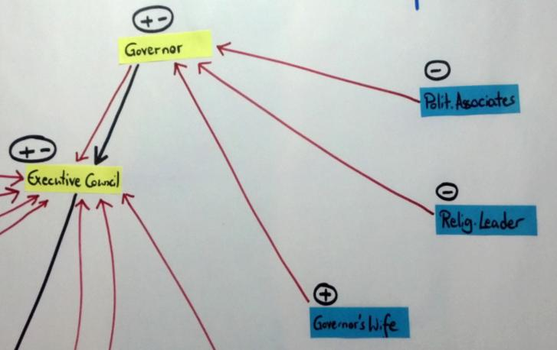
WHAT DO THEY WANT? (1/2)

Slide 13
WHAT DO THEY WANT? (2/2)
Identify who is positive, negative or neutral with regards to achieving the success of the reform;
Indicate next to each actor card with:
  “++” : Strongly positive
  “+” : Positive
  “+/-” : Neutral
  “-” : Negative
  “- -” : Strongly negative

Slide 14
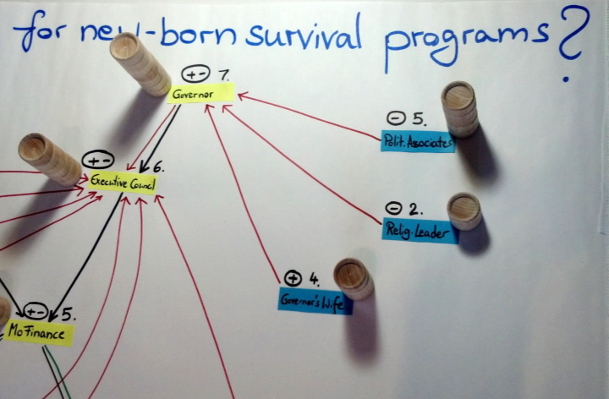
HOW INFLUENTIAL ARE THEY? (1/2)

Slide 15
HOW INFLUENTIAL ARE THEY? (2/2)
Assess how strongly each actor will influence the success of the reform effort;
Use wooden disks to build influence towers next to every actor card to indicate level of influence;
Tower: Ideally put the maximum at 5;
By the end of the exercise, write down the number next to each actor.

Slide 16
WHAT DID WE LEARN FROM NET-MAP?
Bottlenecks and opportunities:
Potential coalitions
Potential opposition
Broader perspective
Missing links
Why projects succeed or fail
Others…

Slide 17
BUILDING STRATEGY
Based on those data, draft the Influence Matrix
Select the 3 to 5 more important actors (Targets)
Hand out arrows indicating recommended moves
Indicate brief description of the moves (discuss)
Indicate who can have significant influences on them (influencers)?
Favor those – influencers – who are open-minded enough for change
Specify the links between those favored influencers and targets

Slide 18
INFLUENCE MATRIX

Slide 19
RECOMMENDED ACTIONS FOR INFLUENCERS (Tab1)

Slide 20
For more information, please contact:
Benjamina M. RANDRIANARIVELO brandrianarivelo@worldbank.org

